Slide 1



AI in Network Science:
Challenges and Opportunities
Boleslaw K. Szymanski
Department of Computer Science
Rensselaer Polytechnic Institute, Troy, NY 12180, USA

Slide 2
Overview
We will discuss the current work of the RPI CS Network Science group which relies on AI to solve some fundamental problems in Network Science.
We will use three examples and discuss for each related work.
Community Structure in Networks
Seeding Information Diffusion
Modeling Evolutionary Dynamics of Groups
Notes:
The scale-free topology has some good properties, including high tolerance to random attacks\citep{albert2000error}, high synchronizability\citep{korniss2007synchronization} and resistance to congestion\citep{toroczkai2004network}.

Slide 3
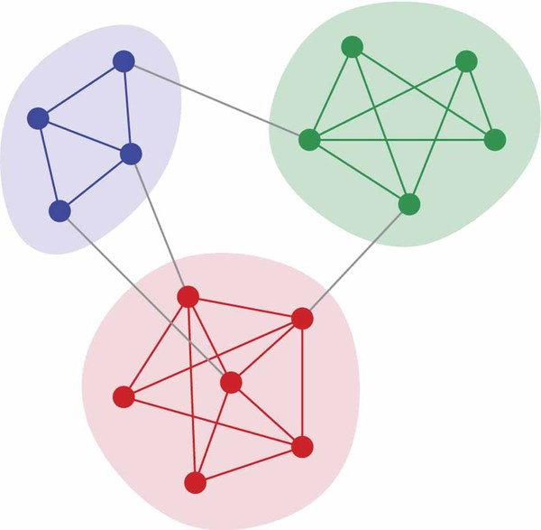
1. Community structure in networks
In complex networks, community (a.k.a. cluster, group, module) members are
  Well connected among themselves
  Relative well separated from the rest
Notes:
The scale-free topology has some good properties, including high tolerance to random attacks\citep{albert2000error}, high synchronizability\citep{korniss2007synchronization} and resistance to congestion\citep{toroczkai2004network}.

Slide 4
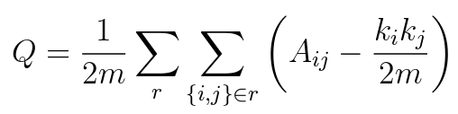



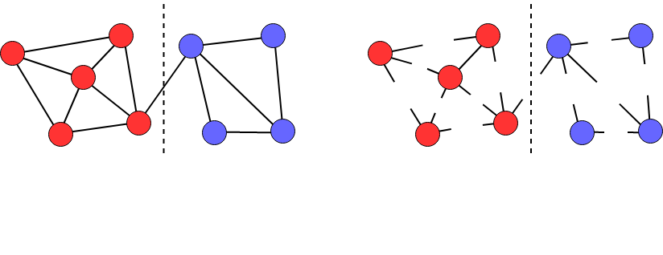
Modularity of community structures
Given a partition of network, modularity compares
vs.
#edges within a community
expected #edges within it
: #edges between nodes i and j in an unweighted undirected multigraph
: degree of nodes i : total #edges
j
j
i
i
Null model: randomize edges, preserving the nodes’ degrees
Notes:
The scale-free topology has some good properties, including high tolerance to random attacks\citep{albert2000error}, high synchronizability\citep{korniss2007synchronization} and resistance to congestion\citep{toroczkai2004network}.

Slide 5
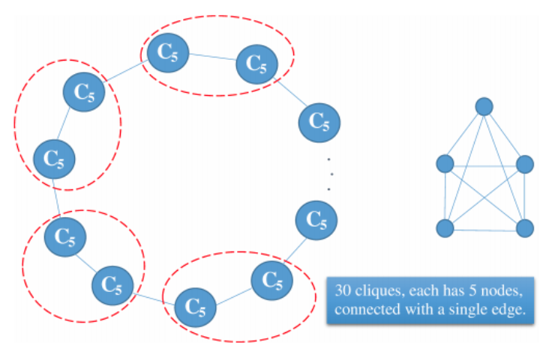
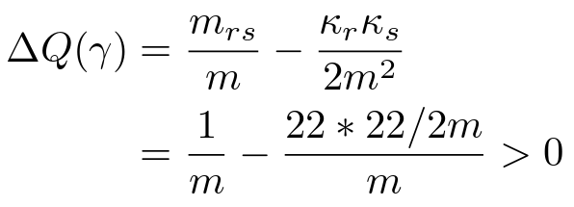

Resolution limit of Modularity
The modularity optimization approaches search for partitions of network maximizing modularity
  The resolution limit problem arises from its definition anomaly
The modularity can be increased by merging two good communities r and s:
r
s
: #edges between two communities
: sum of degree of nodes in community r
Notes:
The scale-free topology has some good properties, including high tolerance to random attacks\citep{albert2000error}, high synchronizability\citep{korniss2007synchronization} and resistance to congestion\citep{toroczkai2004network}.

Slide 6
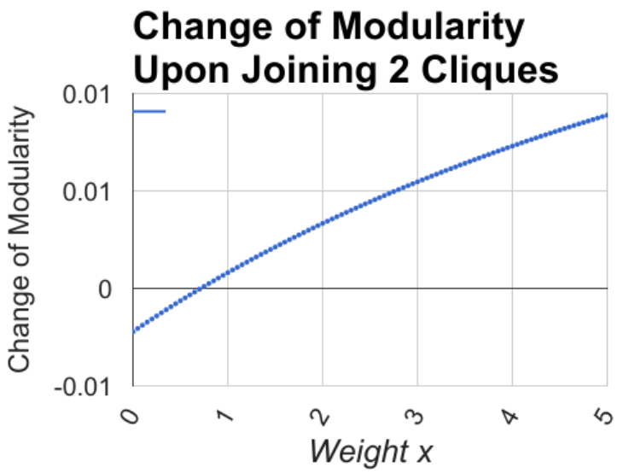
Motivation
New idea: introduce negative edge weights to avoid merging endpoints in the same community thus resolving the resolution limit of modularity
x : the weight of edge between two cliques
x=1
Notes:
The scale-free topology has some good properties, including high tolerance to random attacks\citep{albert2000error}, high synchronizability\citep{korniss2007synchronization} and resistance to congestion\citep{toroczkai2004network}.

Slide 7
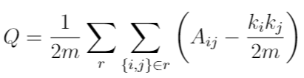
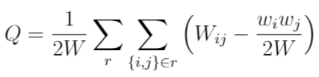


Why does edge weighting work?
The balanced edge weighting scheme preserves the local optimal partition
  Increase the weights of intra-community edges while decrease the weights of inter-community edges
Modularity
Partitions

Slide 8
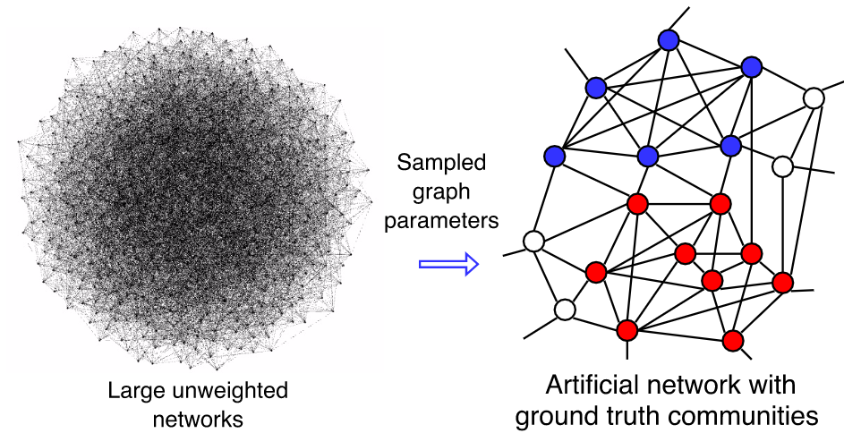
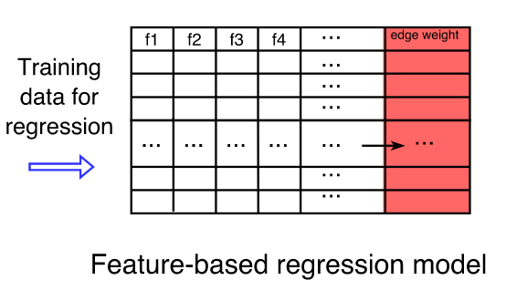
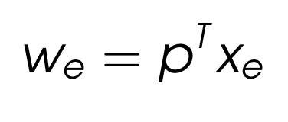
Adaptive Modularity Maximization
Construct an artificial network with known ground truth communities
Extract topology features of the edges xe= [f1, f2,...]
  f1: Common Neighbors
  f2: Jaccard-coefficient
  f3: Adamic-Adar index
Train a feature-based linear regression model on the edge weight we.
Semi-supervised Learning
Notes:
The scale-free topology has some good properties, including high tolerance to random attacks\citep{albert2000error}, high synchronizability\citep{korniss2007synchronization} and resistance to congestion\citep{toroczkai2004network}.

Slide 9
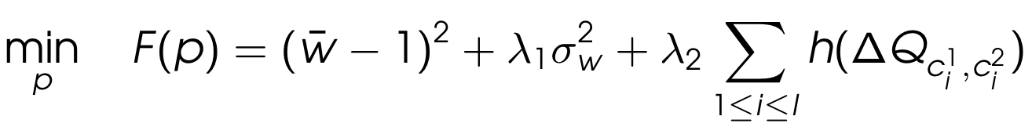
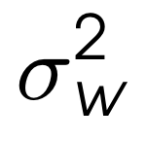
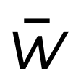
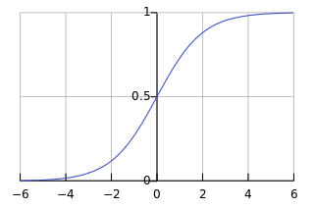
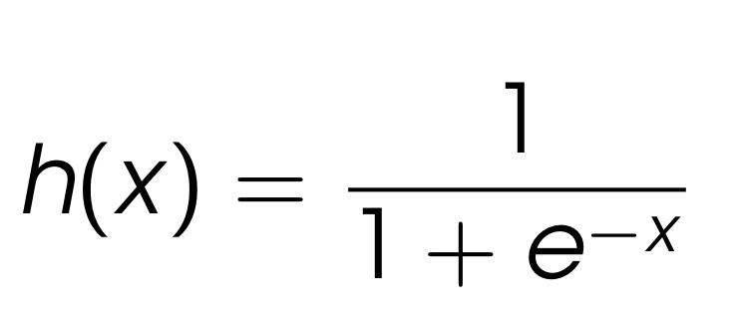
Optimization framework
Penalization on the change of modularity upon joining pairs of small ground truth communities:
Regularization on the variance of the edge weights to control the portion of negative weights and the average edge weight which is expected to be close to 1.
Loss function such as the sigmoid function is used to improve the robustness against outliers.
Notes:
The scale-free topology has some good properties, including high tolerance to random attacks\citep{albert2000error}, high synchronizability\citep{korniss2007synchronization} and resistance to congestion\citep{toroczkai2004network}.

Slide 10
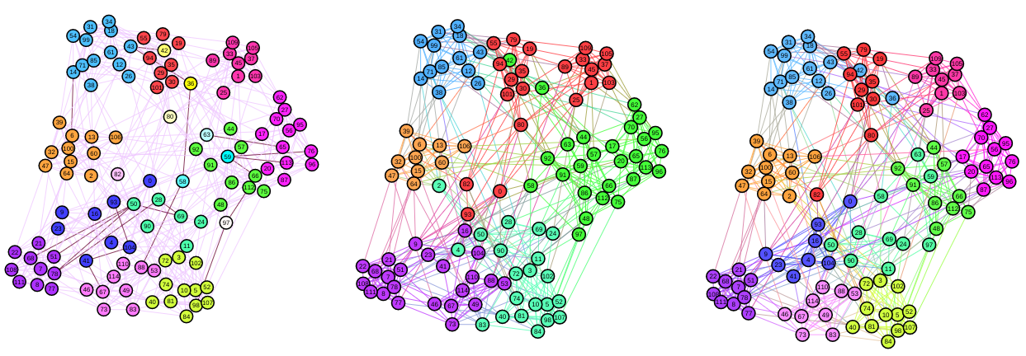
American College Football network
The American college football network consists of 115 college football teams. The teams in the same conference play with each other more frequently than those in different conferences..
(a) 19 ground truth communities defined as 11 conferences and 8 independent teams. Edges in black are assigned negative weights by our model.
(b) 6 communities detected on the unweighted graph by the Fast Greedy modularity maximization method.
(c) 11 communities detected on the weighted graph by the Fast Greedy modularity maximization method.

Slide 11
Improvement on community detection algorithms
The community structures discovered in the original unweighted graph are compared with the corresponding ones detected in weighted graph produced by our model.
The edge weighting scheme improves the performance of the state-of-the-art community detection algorithm (in terms of NMI score in benchmark networks)
  Fast Greedy algorithm by 56%
  Leading eigenvector method by 46%
  Label propagation algorithm by 21%
  Random walks algorithm by 10%
  Multilevel algorithm by 5%

Slide 12


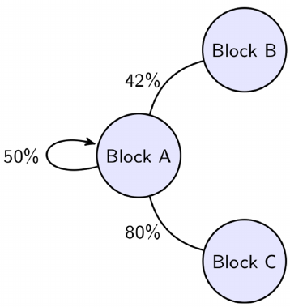
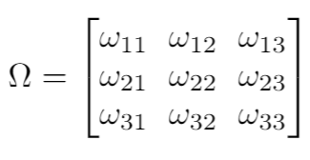
Revisit Modularity: Random Graph models
The degree-corrected Stochastic Block Model (SBM) is a generative model in which
  Each node has a block assignment (Community structure is known)
  #Edges between nodes i, j follows Poisson distribution with mean
Edge Density Matrix of SBM:
Notes:
The scale-free topology has some good properties, including high tolerance to random attacks\citep{albert2000error}, high synchronizability\citep{korniss2007synchronization} and resistance to congestion\citep{toroczkai2004network}.

Slide 13
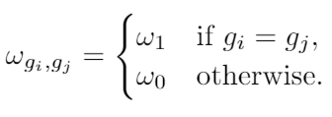
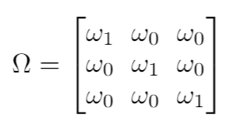
Revisit Modularity: Stochastic Block Model
The degree-corrected Stochastic Block Model (SBM) is a generative model that
  Each node has a block assignment (Community structure is known)
  #Edges between nodes i, j follows Poisson distribution with mean
  Planted Partition Model (PPM) is a special case of SBM
Edge Density Matrix of SBM:
Edge Density Matrix of PPM:
Notes:
The scale-free topology has some good properties, including high tolerance to random attacks\citep{albert2000error}, high synchronizability\citep{korniss2007synchronization} and resistance to congestion\citep{toroczkai2004network}.

Slide 14
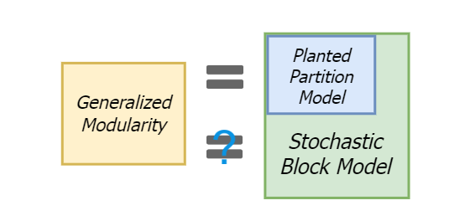
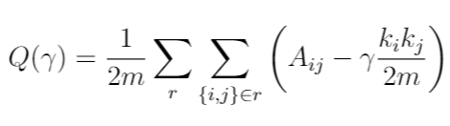
Revisit Modularity: Planted Partition Model
The maximization of the generalized modularity is equivalent to the maximum-likelihood estimation (MLE) of the degree-corrected planted partition model (PPM) on the same graph
How does modularity maximization perform in the graphs generated by SBM?
Resolution Parameter
Notes:
The scale-free topology has some good properties, including high tolerance to random attacks\citep{albert2000error}, high synchronizability\citep{korniss2007synchronization} and resistance to congestion\citep{toroczkai2004network}.

Slide 15
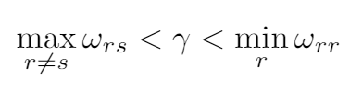
Asymptotic upper and lower resolution bounds
Key results:
  Approximate the #edges between communities r and s using the SBM
  Make sure the change of generalized modularity is negative upon the damaging mergers and splits
Inter-community edge density
Intra-community edge density
This result connects the resolution limit of modularity with the random graph theories
Notes:
Details in thesis

Slide 16
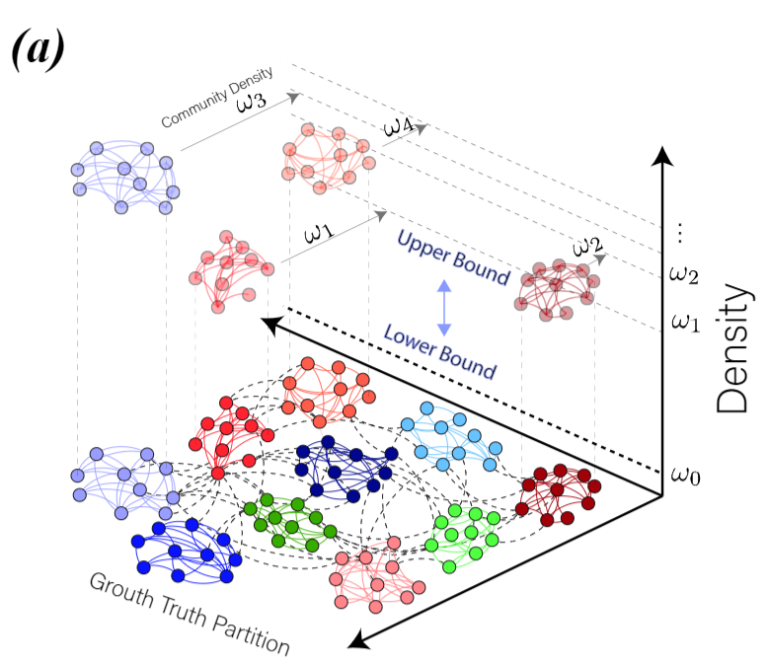
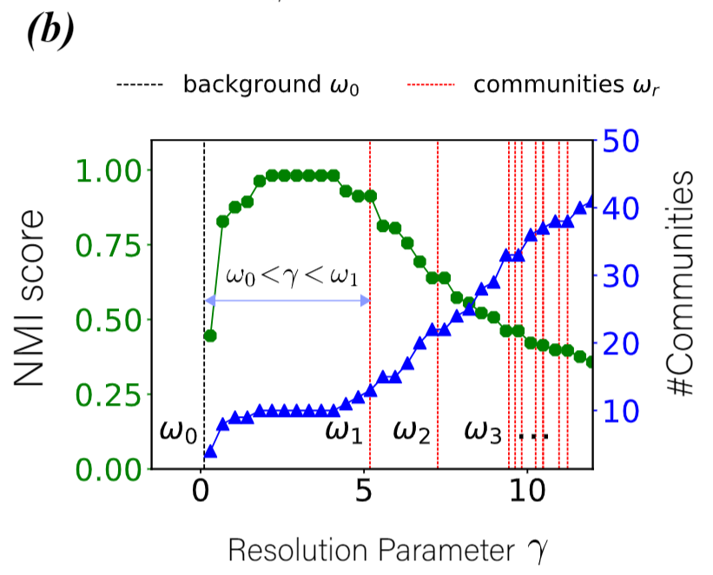

Bounds on resolution parameter
The modularity maximization works correctly only if the resolution parameter resides inside the established bounds
Assume the inter-community edge density is uniformly
Notes:
The scale-free topology has some good properties, including high tolerance to random attacks\citep{albert2000error}, high synchronizability\citep{korniss2007synchronization} and resistance to congestion\citep{toroczkai2004network}.

Slide 17
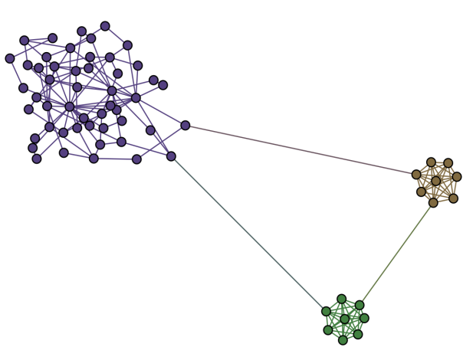
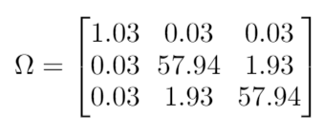
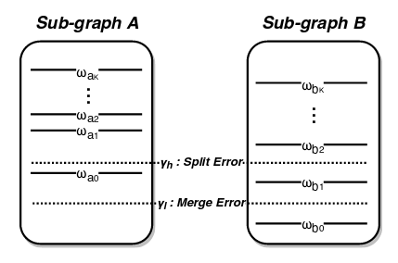
When does Modularity Maximization fail?
There is no suitable resolution parameter to detect the following three communities
Edge Density Matrix (posterior estimates):
Notes:
The scale-free topology has some good properties, including high tolerance to random attacks\citep{albert2000error}, high synchronizability\citep{korniss2007synchronization} and resistance to congestion\citep{toroczkai2004network}.

Slide 18
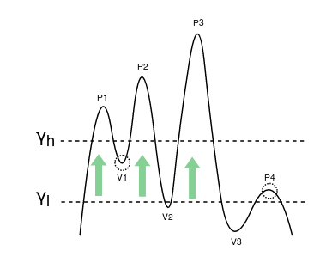
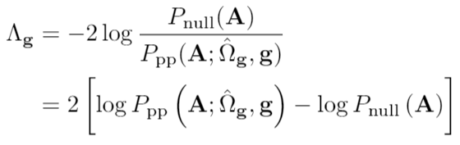
“Plateaus” problem
The plateaus problem is analogous to finding mountains that are located at different plateaus
  Using a single altitude either would miss the lower mountains, or would treat the higher peaks as one mountain
  Solution: detect community at each branch of the recursion; continue if the partition at each branch is statistically significant
Log-likelihood ratio test (LLR):
Null Model H0: degree-corrected random graph
Nested Model H1: degree-corrected PPM
The likelihood of H1 should be much larger than the likelihood of H0
Notes:
Himalaya

Slide 19
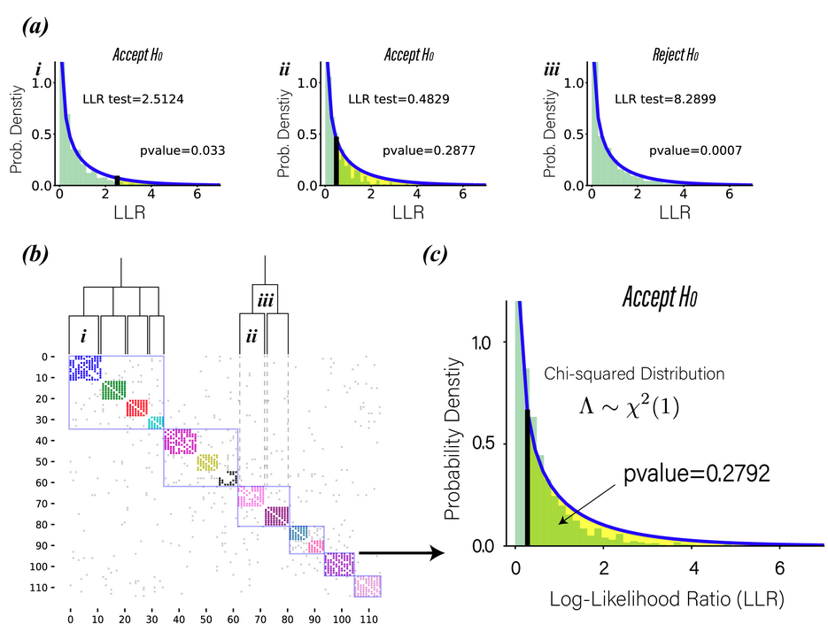
Calculating the P-values
The hypothesis testing framework for statistically significant community detection
Notes:
Highlight my contributions

Slide 20
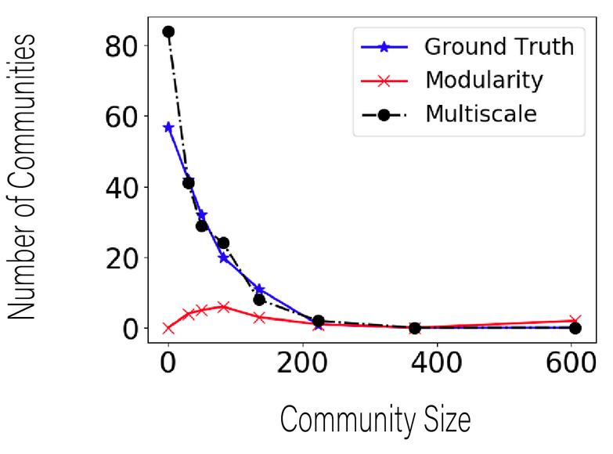
Performance evaluation
In the LFR benchmark networks:
  Ground-truth communities are known
  The community size follows the Power-law distribution
  The proposed multi-scale algorithm out-performs modularity maximization by 38% in NMI and 240% in ARI score
Notes:
The scale-free topology has some good properties, including high tolerance to random attacks\citep{albert2000error}, high synchronizability\citep{korniss2007synchronization} and resistance to congestion\citep{toroczkai2004network}.

Slide 21
Papers
X. Lu, K. Kuzmin, M. Chen, and B. K. Szymanski, “Adaptive Modularity Maximization via Edge Weighting Scheme,” Information Sciences, 424:55-68:, Jan,, 2018, (RPI)
X. Lu, B. K. Szymanski, “A Regularized Stochastic Block Model for the robust community detection in complex networks,” Scientific Reports, 9, Jan., 2019, (RPI)
X. Lu and B. K. Szymanski, “Asymptotic resolution bounds of generalized modularity and multi-scale community detection,” Information Sciences, accepted pending revisions, 2019, (RPI) available at https://arxiv.org/abs/1902.04243

Slide 22
2. Seeding Information Diffusion
2
Threshold Model¹: the rule
→ Binary, deterministic opinion spread model
→ Adoption based on the threshold φ of each node.
Blue : Inactive nodes
Red : Active nodes
For φ = 0.50 at least 3/6 neighbors
must be active in order for the node to
get activated.
Resistance r=ceil(φk) is the minimum
number of activate neighbors required
for activation. Here, r=3 (and k=6 is
the degree of the node)
with more active neighbors…
¹M. Granovetter. AJS , 83(6):pp.1420–1443, 1978
Notes:
With more active neighbors…

Slide 23
Threshold Model: the parameters
Network structure:
Synthetic (random graphs : ER), empirical, assortativity, clustering, etc.
Fraction of the initially active nodes p: small^{2, 3}, varying^{4, 6, 7, 8}
Strategies for selecting the initiators:
Optimal⁵, random^{2, 3, 4, 6}, heuristic^{7, 8}
Threshold of the nodes:
Unique^{2, 3, 4} , Uniform Random⁵ , Normal distributon⁶ ,Log-normal⁹
More realism: spontaneous innovation⁹,fraction of immune nodes⁹
²DJ Watts, PNAS 99(9):5766–5771, 2002
³JP Gleeson et al., PRE, 75, 056103, 2007
⁴P Singh et al., Sci. Rep. 3, 2330, 2013
⁵D Kempe et al., ACM SIGKDD 2003
⁶P Karampourniotis et al. PLOS One, 2015
⁷X Pei et al., Sci Rep, 2017
⁸P Karampourniotis et al. (preprint, 2017)
⁹Ruan et al. PRL (2015); Karsai et al. (2016).
Notes:
Research in the TM is focused on measuring the Cascade size governed by a variety of parameters.
->Of course, the final Cascade size will depend on the Network Structure.
It will also depend on the fraction of the initially active nodes.
In the past all of the research was focused for small initiator sizes, but only last year, our group investigated the case of varying initiator sizes for a unique threshold in the network.
->In addition, another parameter is the strategies for Selecting the Initiators. However, there is not a single selection strategy that is the best for different network structures so far. The seminal work of Kempe, showed that finding the optimal set of initiators is a np-hard problem.
The simplest strategy of selecting the initiators is random selection, followed by some heuristic strategies.
->Lastly, the Cascade size depends (as we will see later) in the threshold distribution of the nodes.
Most of the work in the past, including ours, was focused in a unique threshold for the whole network Or to a uniform distribution of Thresholds.
A model with the extremes of a unique threshold or a uniform distribution of thresholds does not capture
the complex nature of social influencing when multiple initiators are present.

Slide 24
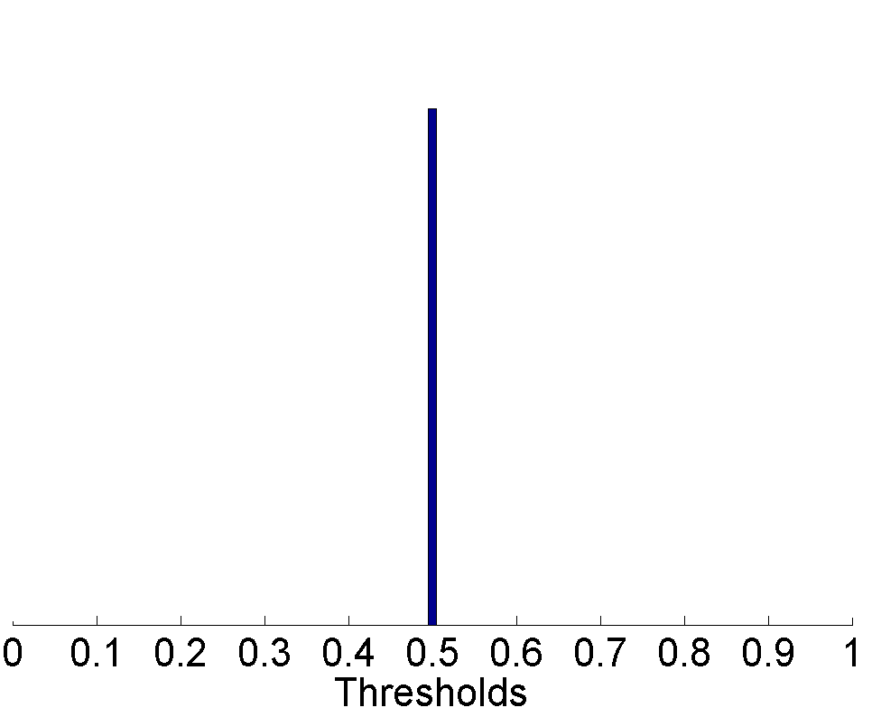
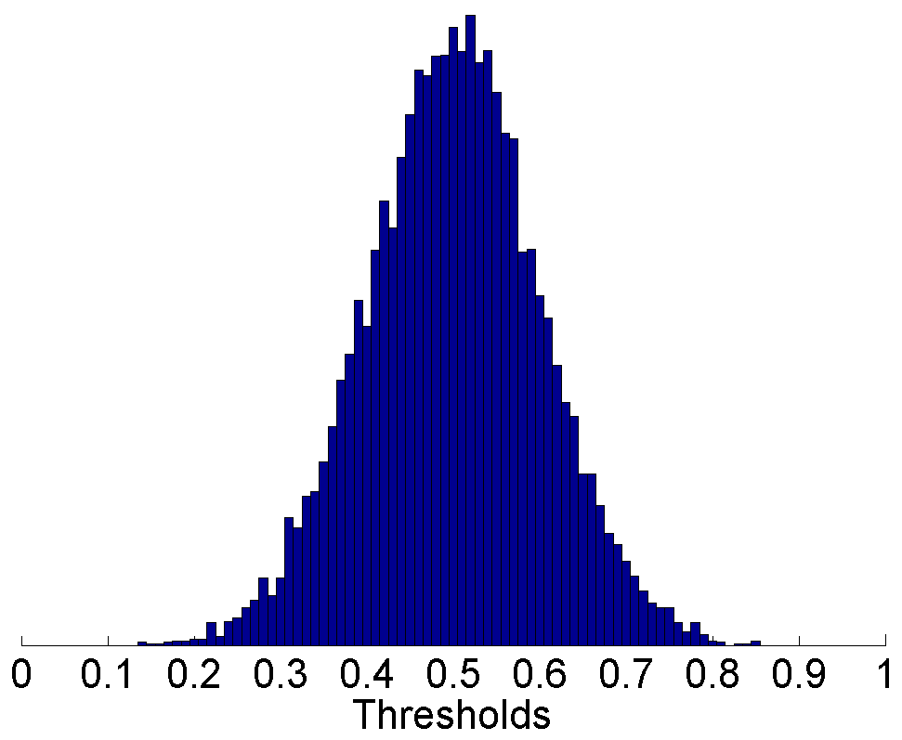
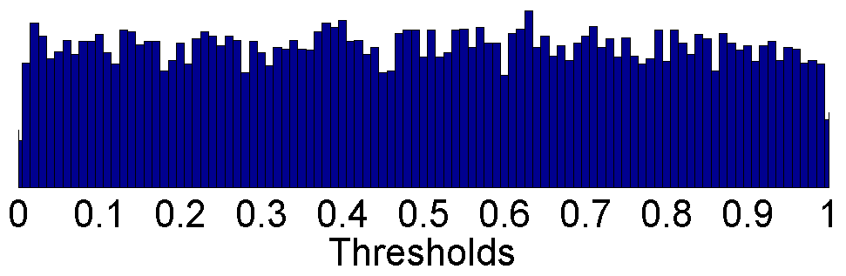
Threshold distribution
Truncated Normal Distribution P(φ) = Ν(φ₀, σ)
Threshold of each node: 0 ≤ φ ≤ 1
Mean threshold: 0 ≤ φ₀ ≤ 1
Standard deviation: 0 ≤ σ ≤ 0.289
Delta Distr.
σ = 0.00
σ = 0.10
Uniform Distr.
σ = 0.289
Notes:
In this work, we use simulations to investigate the transition in the behavior of threshold-limited cascades
as the distribution of thresholds is varied from the extremes of a delta function to a uniform distribution.
Impact of the phase transition.
Specifically, we study cascades in the TM when nodes are assigned a threshold value
drawn from the Normal distribution with varying mean threshold φ_0 and standard deviation σ.
For σ=0.00 we have a unique threshold…

Slide 25
Influence Maximization (IM)
Knowledge of threshold distribution
Regardless of what the threshold distribution is, the knowledge of the thresholds is important for IM.
Zero Information on threshold/distribution¹
  Assume a uniform probability distribution for each node. Hence, a node with degree k has equal probability of having any resistance from 1, …, k.
  Focus on activation probability.
  NP-hard
Some Threshold Distribution information for each node
  Data inferred probability distribution
  NP-hard
Complete threshold information for each node (drawn from some distribution)
  Data inferred specific threshold
  NP-hard ²
¹Kempe et al., SIGKDD ’03 (2003), ²Lu et al., 31st Intern. Conf. DCSW (2011)
Notes:
Information on the thresholds is very important for the selection strategies.
There are three cases,
1) no information on threshold distribution. Then we have to assume that any node has a uniform probability distribution.
2) Some information with uncertainty around the threshold of each node (thus a also mentioned as Complex Contagion).
3) No uncertainty.
All of them are NP-hard, We will be focusing

Slide 26
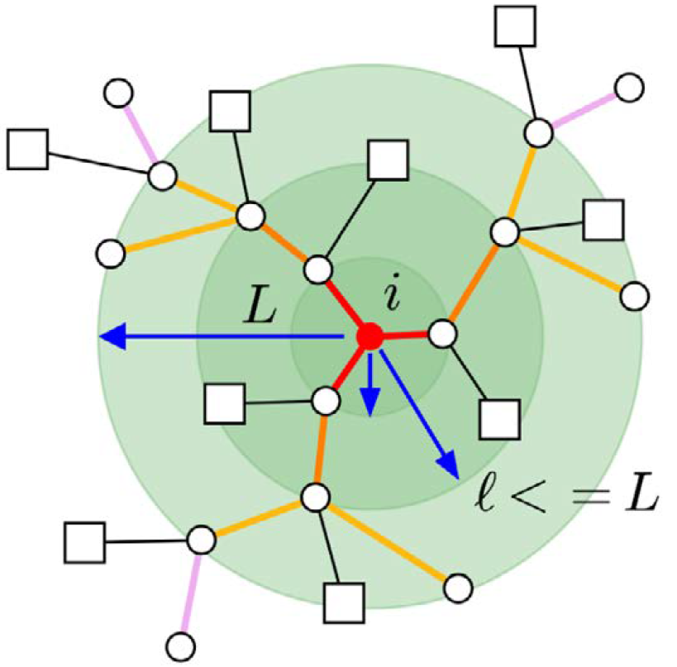

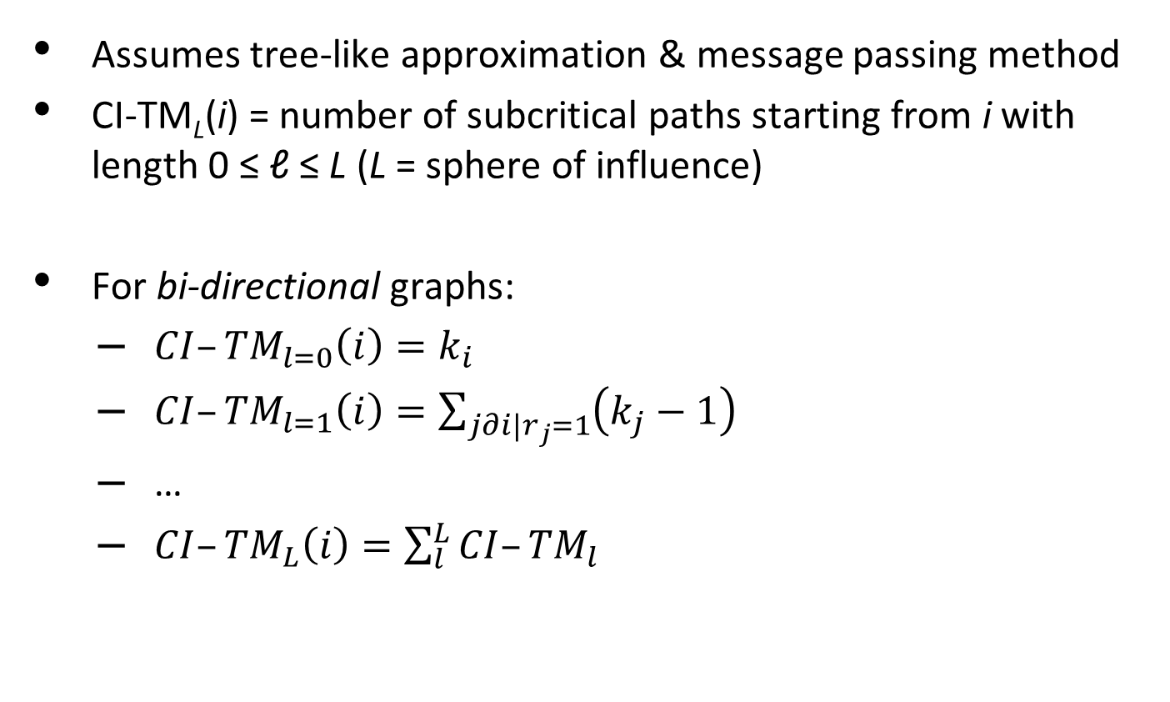
Collective Influence^{1,2} for $σ≈0$
Assumes tree-like approximation & message passing method
CI-TM_{L}(i) = number of subcritical paths starting from i with length 0 ≤ ℓ ≤ L (L = sphere of influence)
For bi-directional graphs:
  ${CI–TM}_{l=0}\left(i\right)=k_{i}$
  ${CI–TM}_{l=1}\left(i\right)=\sum_{j∂i|r_{j}=1}{\left(k_{j}−1\right)}$
  …
  ${CI–TM}_{L}\left(i\right)=\sum_{l}^{L}{{CI–TM}_{l}}$
¹Morone, Makse. Nature 524, 65-68 (2015)
²Pei, Shaman, Morone, Makse. Sci Rep 7: 45240 (2017)
Notes:
However, when the resistance is not r=k-1,
There is spread involved, and they came up with CI-TM algorithm to track the spread.
Metric + spread computation combined.
message passing equations of LTM,
For the σ=0 the tipping point of the giant component is equivalent to the tipping point of the total cascade size

Slide 27
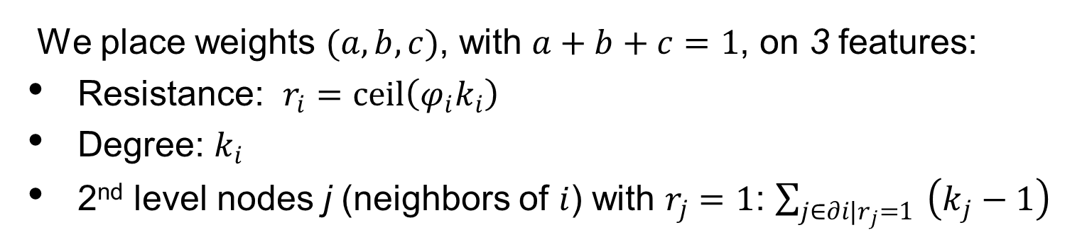
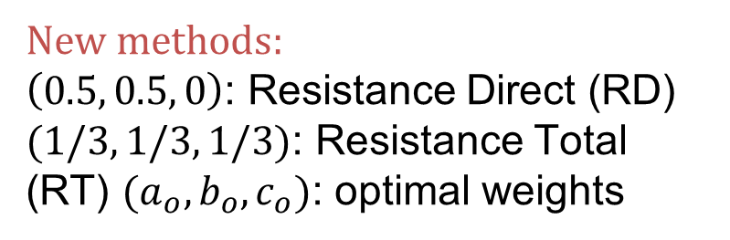
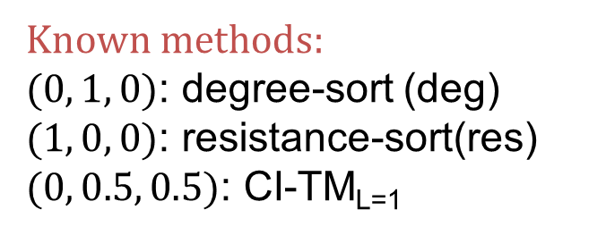
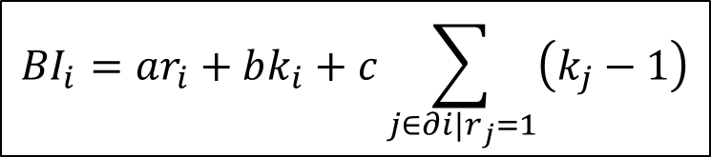
Balanced Index strategy (BI)
We place weights $(a,b,c)$, with $a+b+c=1$, on 3 features:
Resistance: $r_{i}=ceil\left(φ_{i}k_{i}\right)$
Degree: $k_{i}$
2nd level nodes j (neighbors of $i$) with $r_{j}=1$: $\sum_{j∈∂i|r_{j}=1}{ \left(k_{j}−1\right)}$
$${BI}_{i}=ar_{i}+bk_{i}+c\sum_{j∈∂i|r_{j}=1}{\left(k_{j}−1\right)}$$
Specific cases of choices of weights:
Known methods:
$(0, 1, 0)$: degree-sort (deg)
$(1, 0, 0)$: resistance-sort(res)
$(0, 0.5, 0.5)$: CI-TM_{L=1}
New methods:
$\left(0.5, 0.5, 0\right)$: Resistance Direct (RD)
$(1/3, 1/3, 1/3)$: Resistance Total (RT) $(a_{o}, b_{o}, c_{o})$: optimal weights

Slide 28
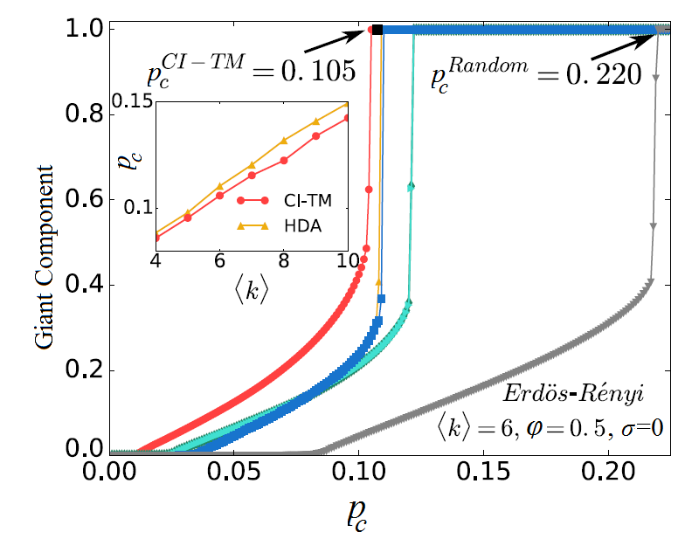
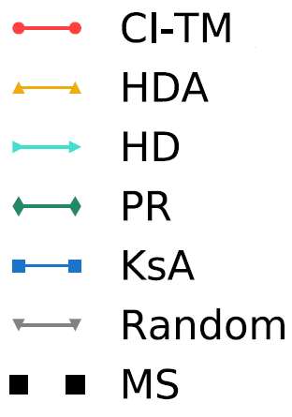

Collective Influence¹ for $σ≈0$
CI-TM
degree (dyn)
degree (stat)
Page-Rank
k-core (dyn)
Random
MS Alg.²
Giant Active Component
ER, N = 100000
<k> = 6, φ₀ = 0.50
¹Pei, Shaman, Morone, Makse. Sci Rep 7: 45240 (2017)
²Altarelli, et al. Phys Rev E 87, 062115 (2013)
Notes:
However, when the resistance is not r=k-1,
There is spread involved, and they came up with CI-TM algorithm to track the spread.
Metric + spread computation combined
For the σ=0 the tipping point of the giant component is equivalent to the tipping point of the total cascade size

Slide 29
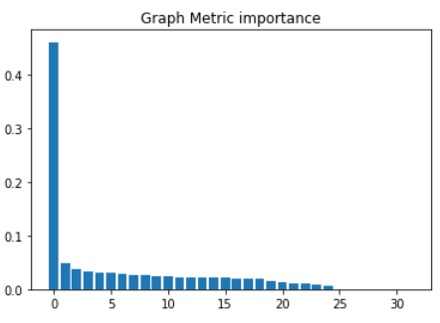
Random Forest Classification model
trained on ER graphs
Rank | Feature | Average Captured Importance | Computation Complexity
1 | Threshold Distribution σ (mean=0.5) | 0.511602 | (artificial)
2 | Degree Assortativity | 0.02727 | (inherent, artificial- edge swapping)
3 | Variance of Neighbors' Degree | 0.026698 | O(1)
4 | Variance of Closeness | 0.026175 | O(V^3)
5 | Variance of Clustering Coefficient | 0.026113 | O(1)
6 | Density | 0.025722 | O(1)
7 | Variance of Degree | 0.025327 | O(1)
8 | Average Clustering Coefficient | 0.024879 | O(1)
9 | Average Neighbors' Degree | 0.024507 | O(V)
10 | Variance of Shortest Path Length | 0.024160 | O(E log V)

Slide 30
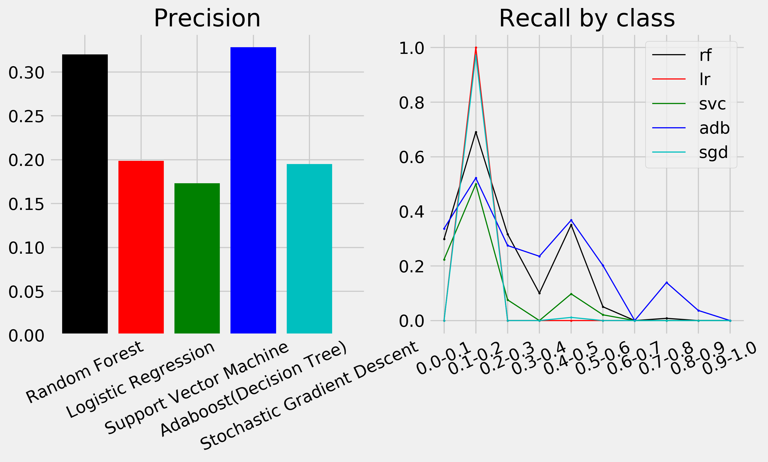
Random Forest Classification model: results
Different ML model performance. Decision trees ensemble methods seem to perform the best (rf - “Random Forest”, “adb” - “AdaBoost using Decision Trees”)

Slide 31
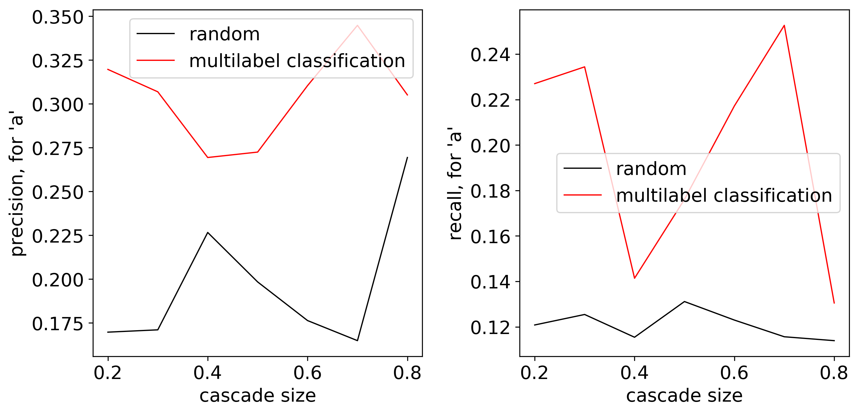
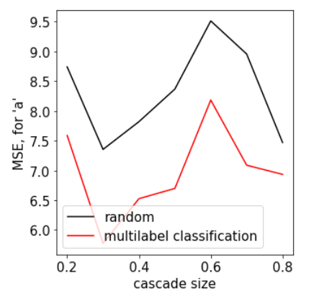
Analysis of performance of the direct method
1. Precision & Recall
2. MSE

Slide 32
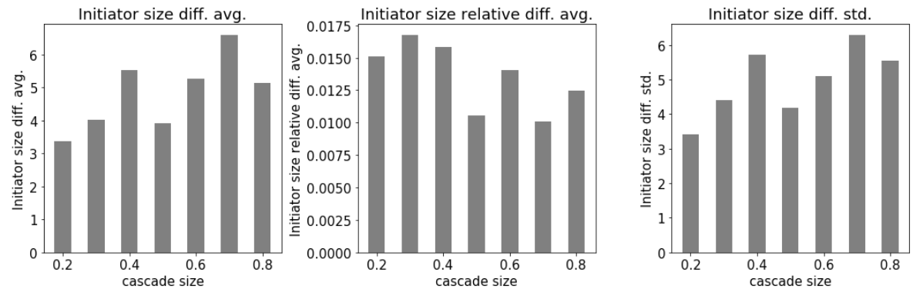
Analysis of performance of the direct method:
seed set size
Initiator Size Difference

Slide 33
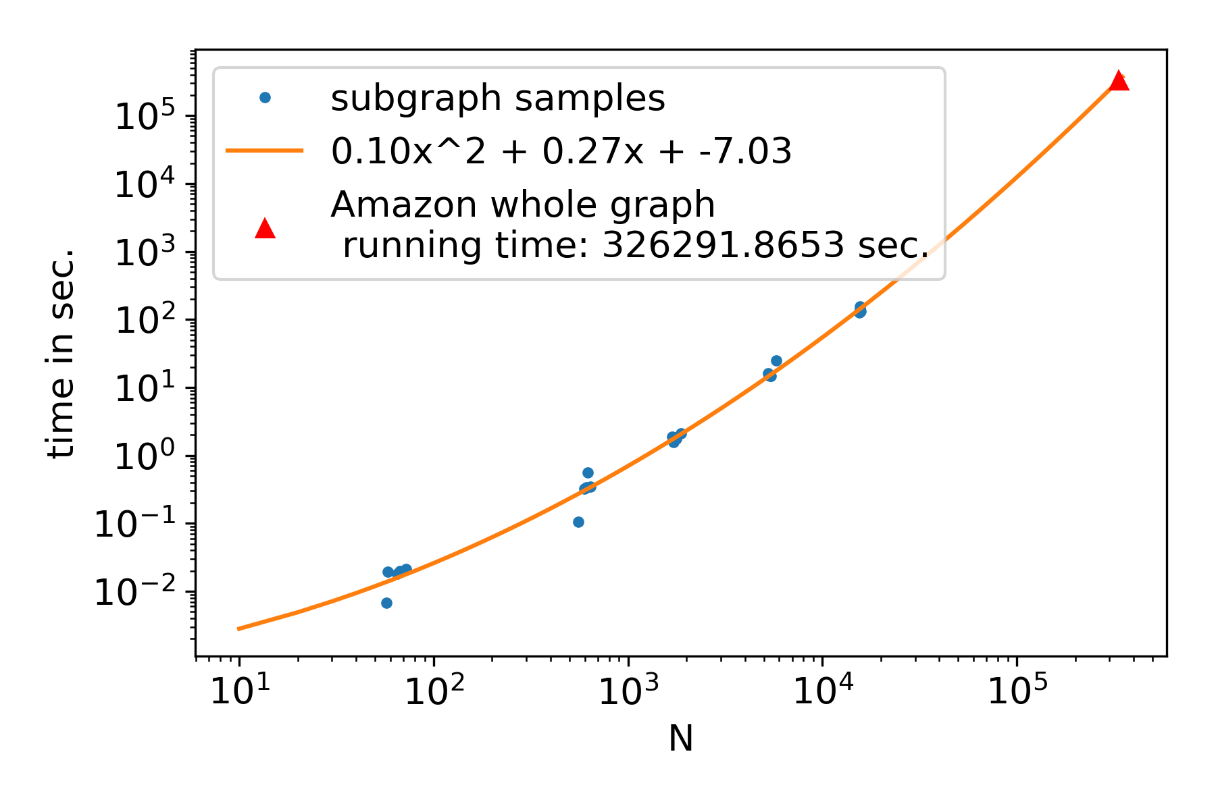
Using subgraph sampling to enhance ML model training
1. Subgraphs have features similar to features of the original graph (compared to ER graphs and other synthetic graphs)
2. Statistically, we could see a significant tendency that the cumulative distribution of subgraph results are converging to the central, which renders meaningful sampling results.
3. On the Amazon co-purchasing network dataset having over 300,000 nodes and 900,000 edges:
Designed random walk sampling to sample small subgraphs.
Run a grid search to get ground truth best BI parameter values for both subgraphs and the original graph
Running time estimation for original large graph

Slide 34

Clustering of subgraphs using Euclidian distance metric
Left cluster contains subgraphs created via random walks through the target graph
(1) Subgraph samples
(2) ER synthetic graphs
Right cluster contains ER graphs of the same average degree as the target graph
Amazon Network
Euclidean distance nearest neighbor clustering of subgraphs created to find optimal parameters.

Slide 35

Analysis of performance of the ML based method
Differences between ground truth best (a, b) parameters for graph samples and the original large graph; Using 100, 500, and 1000 samples; Distribution summarization is based on 147 experiment configurations

Slide 36


Analysis of performance of the ML based method
Difference between found versus
the ground truth best values of parameter a
Differences between seed sizes found and actual
Conclusion: use of subgraph sampling enhances the machine learning model for predicting the best parameters for BI.

Slide 37

Summary
Balanced Index Strategy
  Optimizes weights of simple (and fast) features
  Optimal weights for any σ:
  $a_{0}≈0.53, b_{o}≈0.32, c_{0}≈0.15$
  Best performing strategy (excluding GPI) for any threshold standard deviation σ and assortativity ρ
  Fast with O(N log(N)) (for sparse graphs)
  Machine learning on subgraphs can quickly find parameters close to optimal
  Karampourniotis, Szymanski, Korniss, Panagiotis
  Scientific Reports 9 5573 (2019).

Slide 38
Papers
P. Singh, S. Sreenivasan, B. K. Szymanski and G. Korniss, “Threshold-limited spreading in social networks with multiple initiators,” Scientific Reports 3:2330, July 2013 (RPI).
P. D. Karampourniotis, S. Sreenivasan, B. Szymanski, and G. Korniss, “The Impact of Heterogeneous Thresholds on Social Contagion with Multiple Initiators,” PLoS One 10(11), e0143020. Nov., 2015 (RPI).
P. D. Karampourniotis, B. K. Szymanski, and G. Korniss, “Influence Maximization for Fixed Heterogeneous Thresholds,” Scientific Reports 9:5573 April, 2019 (RPI).
Manuscript in preparation for Information Sciences by M. Ma, G. Korniss, and B.K. Szymanski (RPI)

Slide 39
3. Modeling Evolutionary Dynamics of Groups
Overview:
We study stable groups in a face-to-face interactions network based on Bluetooth proximity records.
We discuss a method of identifying small, stable groups which have face-to-face meetings.
We find if node attributes play a role in the formation of groups
We discuss a method which predicts changes of groups and opinions made by people
Do nodes with certain opinions and in certain environments have better social lives?
Notes:
----- Meeting Notes (7/24/18 12:49) -----
interaction behaviora

Slide 40
What kind of groups do we discover?
We discover groups with the following properties:
  Stable over time, a semester for example
  Repeated, face-to-face interactions
How is this different from community detection:
  Based on non-aggregated F2F interactions
  Bluetooth interactions network is very dense with several overlapping communities
  Discover groups directly from interactions.

Slide 41

How are groups discovered?
Groups discovered for every semester
  Get multiple snapshots of network over time, of 10 minutes
  Identify connected components in each snapshot. This is a potential group.
  However,
    Members might be missing on certain meetings
    Visiting members might be present on certain meetings
    Group might evolve a little during the course of time
  Merge these components across time using certain rules.
Image credit: Sekara, V., Stopczynskia, A., Lehmann, A.: Fundamental structures of dynamic social networks, Proceedings of the National Academy of Sciences, USA 113 (36), (2016)

Slide 42

Creation of groups
Hierarchical clustering based method
Input: Connected components, with number of meetings
Output: Groups
Parameters: intersection threshold T_{i}, membership threshold,T_{m} member-intersection threshold, T_{mi}.
  Merge groups using hierarchical clustering
  Merge a pair of groups if:
    Intersection of members > T_{i}
    Regular member: one with percentage of attendance > T_{m}
    Intersection of potential members > T_{mi}
    Add intersecting and potential members of both groups.
  Stop merging when no new eligible members are found
Image credit: sciencedirect.com

Slide 43
Merging of components
Not regular members
Regular members
  intersection threshold = 0.6,
  membership threshold = 0.3,
  member-intersection threshold = 0.5
The membership threshold decides this value
New group- A, C, D, E.
No merge
No merge
Component 1
Component 2
Component 1
Component 2
Component 1
Component 2
A
B
C
D
E
F
A
B
C
D
E
F
A
B
C
D
E
F
Intersection = 4/6 = 0.66
Number of potential members = 4
Intersection of potential members = 3/4 = 0.75
Intersection = 4/6 = 0.66
Number of potential members = 3
Intersection of potential members = 1/3 = 0.33
Intersection = 2/6 = 0.33

Slide 44
Groups discovered
With certain values on the thresholds:
  intersection threshold = 0.6, membership threshold = 0.3, member-intersection threshold = 0.5
  Number of nodes: 200
  Number of groups: 256
  Average Group Size: 4.1
  Average member attendance: 91%
Higher levels of thresholds: smaller groups with higher attendance than the current groups
Lower levels of thresholds: Larger groups with lower attendance than the current groups
Impact of Attributes on Group Formation, Ashwin Bahulkar, Boleslaw K. Szymanski, Kevin Chan, and Omar Lizardo, International Conference on Advances in Social Networks Analysis and Mining (ASONAM), Barcelona, Spain, 2018.

Slide 45
Group relations significance
In the communication layer of the network:
  Communication Contacts are by definition 1 hop away
  Group Contacts are < 2 hops away from each other
  A random two nodes are 4 hops away
In the nomination layer:
  Random two contacts are 4 hops away
  Group Contacts are 2.5 hops away
  Communication Contacts are 1.2 hops away
  Nomination Contacts are by definition 1 hop away
Implication: Although group contacts are not as “close” as communication or nomination contacts, they are “closer” than random pair of nodes.

Slide 46
Clustering of groups on attributes
Groups are clustered based on attributes
Vector for group:percentage of members with particular attribute value. All values form a vector.
Neat, opinion based clusters of groups are seen.
Liberal leaning groups
K=2
Conserva-tive groups
K=3
Moderately Liberal groups
Strongly Liberal groups

Slide 47
Modeling group membership decisions
People make the following kinds of choices:
  Join a new group
  Leave an existing groups
  Change an opinion
Nodes derive benefit from group membership:
  Through interactions
  Through level of friendliness of discussion measured by similarity of opinions in a group

Slide 48
Problem statement
Predict which changes people will make:
  Which new groups will a person join
  Which groups will a person leave
  Which opinions will a person change
More interactions
More interactions
Stay?
Join
Leave?
Less interactions
More interactions
Leave or Change opinion?

Slide 49




Selfish model for predicting change
Benefit derived from a change of the number of groups
Function of the number of groups
Penalty for prediction for joining a group
Interactions and similarity with group
Variable defining whether the change is made
Penalty for prediction of opinion change
Change in a_{ps} due to opinion change
Total penalty for a prediction
For all nodes
Penalties for the 3 kinds of actions

Slide 50
Altruistic model for predicting changes
In the presented model only individual benefit derived from a group interaction defines the each participant decisions, The two drawbacks are:
no interest of members in the affected group with the same opinions are considered in decisions about changes, and
oscillation of the changes that merely reverse each other are theoretically possible, although we did not observed them in reality.
To avoid the drawback, we introduce the general polarization score which allows a node to consider a change only when it increases the individual score of the mover (selfish part) and the global polarization (altruism score since the global benefit from group interactions increases). This also does not allow for reversible moves, because polarization grows after each move and reversing it would lower polarization. The total benefit B_{g} of a change is:

Slide 51
Testing the model
Model fitting: Find the value of the parameter ‘x’ (ratio of opinion weight to number of group weight) that maximizes agreement with past data
For each person, calculate the cost of predicting every possible set of changes
Choose the set of changes with the least penalty
Group 1 | Group 2 | Group 3 | New group 1 | Opinion 1
1 | -1 | 1 | -1 | -1
1 | 1 | -1 | 1 | 1
1 | -1 | 1 | 1 | 1
Examples of different sets of changes where 1 show agreement with data and -1 disagreement

Slide 52
Machine Learning approach
No limit on the number of introduced features and ability to address imbalanced training set problem
Every training sample: set of changes, yes/no for each group/opinion
What do we predict?
  Would a person perform a set of changes in real life?
  To learn, regress the features against Jaccard similarity between the set of changes and real life changes.
For Features:
  Interactions with each group; for existing and potential groups
  Similarity with each group; for existing and potential groups
  Number of groups
  For opinion change: change in benefit for each opinion

Slide 53
Results
We look at the recall for the 3 kinds of changes:
The analytical model does much better than the baseline, but in turn is outperformed by the machine learning approach.
Precision and overall accuracy also improve with the analytical model and machine learning approach.
Method, % | Join a new group | Leave a current group | Change an opinion
Baseline | 6 | 11 | 13
Model | 65 | 71 | 23
Machine Learning | 89 | 81 | 85
Preparing to submit to Nature Human Behavior

Slide 54
Holding popular opinions improves group interactions
Majority Nodes: nodes whose opinions are in the majority
Majority nodes derive more benefit from participation in social groups meetings than others
They are less likely to change groups compared to others
They are also less likely to change opinions

Slide 55
Conclusions
We demonstrate a methodology for identifying groups of stable and frequently interacting nodes.
Group relationships are stronger than random edges, however, are more fragile than communication relationships.
Groups are biased on several attributes and can be well clustered.
We demonstrate a model for prediction of group and opinion change.
We see that people who are in the majority derive more benefits from groups and change less often.

Slide 56
Papers
A. Bahulkar, B. K. Szymanski, K. Chen, O. Lizardo, “Impact of Attributes on Group Formation,” in Proc. IEEE/ACM Int. Conf. Advances in Social Networks Analysis and Mining (ASONAM), Barcelona, Spain, 2018, pp. 1250-57. (RPI, ARL, NDU collaboration)
Manuscript in preparation for Nature Human Behavior by J. Flamino, A. Bahulkar, B. Szymanski, K. Chan and O. Lizardo (RPI, UCLA, NDU collaboration)
Similar methodology applied to nodes changing opinion or friends presented in:
A Nigam, K. Shin, A. Bahulkar, B. Hooi, D. Hachen, B. K. Szymanski, C. Faloutsos, N. V. Chawla, “ONE-M: Modeling the Co-evolution of Opinions and Network Connections,” in Proc. ECML-PKDD, Dublin, Ireland, Sept 10-14, 2018, Lecture Notes on Artificial Intelligence, 11053: 122-140, Springer, Berlin, 2019.(RPI, CMU, NDU collaboration)

Slide 57
Thank you!
Questions?

